Slide 1
Introduction to Harmonic Balance method

Slide 2
Table of contents
Background
Basic ideas
Challenges and solutions

Slide 3
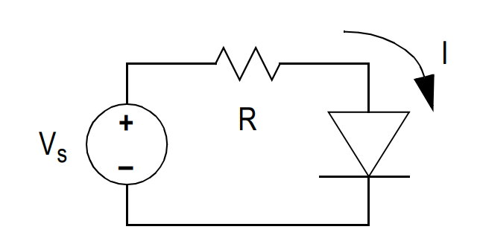
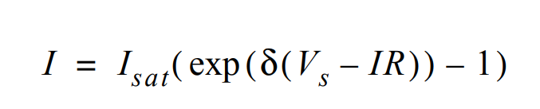
What is HB?
A frequency domain method to calculate the steady-state period solution of nonlinear ordinary differential equations
Mostly applied to nonlinear Microwave circuits
???

Slide 4
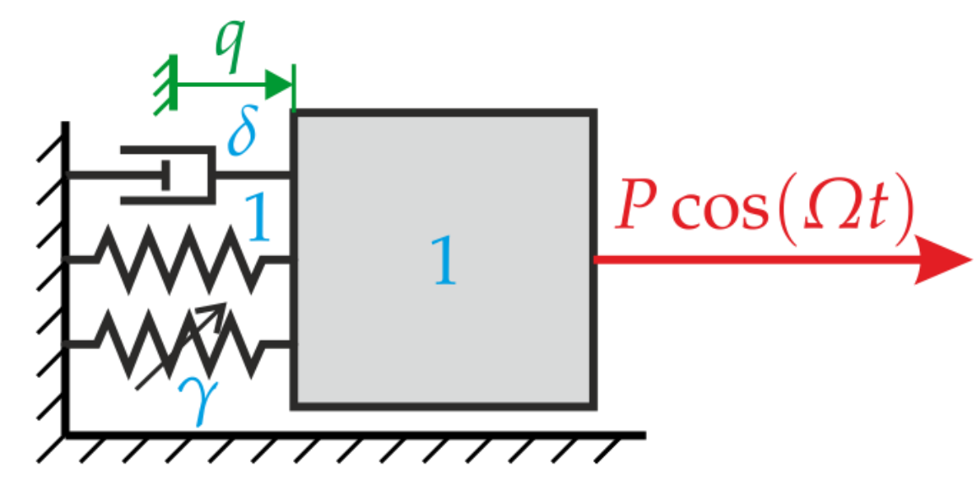
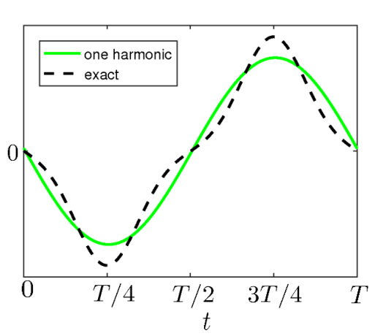


Where is HB?
In almost every circuit simulation softwares
In structural mechanics analysis, e.g., nonlinear vibrations

Slide 5
Why HB?
Efficient compared to numerical integration method
Transient part of the response may be long
Better numerical stability
Numerical truncation error
Some equations are more conveniently described in frequency-domain

Slide 6

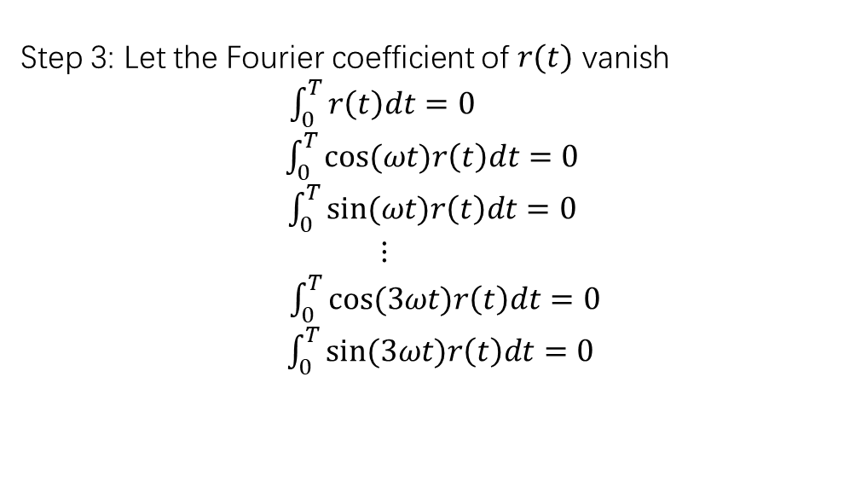

Basic ideas of HB
Consider the simple circuit problem in the beginning:
$$V_{s}=V_{0}sin⁡(ωt)$$
Step 1: Ansatz solution
$I\left(t\right)=a_{0}+a_{1}cos\left(ωt\right)+b_{1}sin\left(ωt\right)+a_{2}cos\left(2ωt\right)+b_{2}sin\left(2ωt\right)$+ $a_{3}cos\left(3ωt\right)+b_{3}sin\left(3ωt\right)$
Step 2: Get residual term
r$\left(t\right)=I\left(t\right)−I_{sat}(exp\left(δ\left(V_{0}\sin\left(ωt\right)−I\left(t\right)R\right)\right)−1)$
Step 3: Let the Fourier coefficient of $r(t)$ vanish
$\int_{0}^{T}{r\left(t\right)dt=0}$
$\int_{0}^{T}{cos⁡(ωt)r\left(t\right)dt=0}$
$\int_{0}^{T}{sin⁡(ωt)r\left(t\right)dt=0}$
$$⋮$$
$\int_{0}^{T}{cos⁡(3ωt)r\left(t\right)dt=0}$
$\int_{0}^{T}{sin⁡(3ωt)r\left(t\right)dt=0}$
(Galerkin method)
$$\left[\begin{aligned}a_{0} \\ a_{1} \\ b_{1} \\ a_{2} \\ b_{2} \\ a_{3} \\ b_{3}\end{aligned}\right]$$

Slide 7
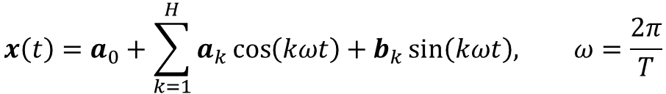
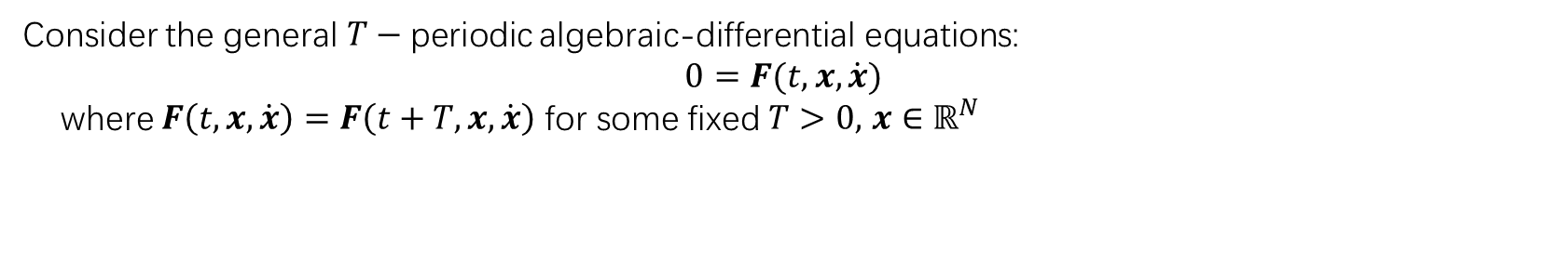
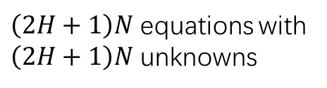
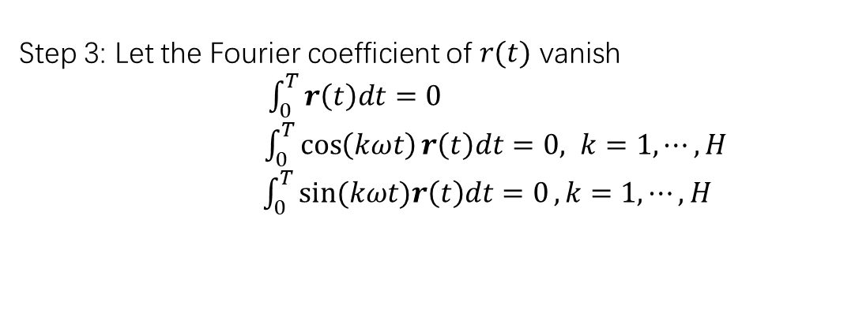
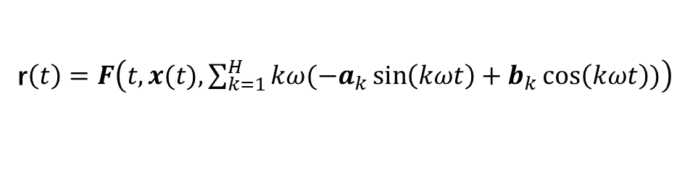
General (one tone) HB method
Consider the general $T−$periodic algebraic-differential equations:
$$0=F(t,x,\dot{x})$$
where $F\left(t,x,\dot{x}\right)=F\left(t+T,x,\dot{x}\right)$ for some fixed $T>0,$ $x∈ℝ^{N}$
Step 1: Ansatz solution
$$x\left(t\right)=a_{0}+\sum_{k=1}^{H}{a_{k}}\cos\left(kωt\right)+b_{k}\sin\left(kωt\right), ω=\frac{2π}{T}$$
Step 2: Get residual term
r$\left(t\right)=F\left(t,x(t),\sum_{k=1}^{H}{kω(−a_{k}}\sin\left(kωt\right)+b_{k}\cos\left(kωt\right))\right)$
Step 3: Let the Fourier coefficient of $r(t)$ vanish
$\int_{0}^{T}{r\left(t\right)dt=0}$
$\int_{0}^{T}{\cos\left(kωt\right)r\left(t\right)dt=0, k=1,⋯, H}$
$\int_{0}^{T}{sin⁡(kωt)r\left(t\right)dt=0},k=1,⋯, H$
(Galerkin method)
$\left(2H+1\right)N$ equations with
$\left(2H+1\right)N$ unknowns

Slide 8

General (one tone) HB method
Let $c=\left[\begin{aligned}\begin{aligned}\begin{aligned}\begin{aligned}a_{0,1} \\ a_{1,1}\end{aligned} \\ b_{1,1}\end{aligned} \\ ⋯ \\ b_{H,1} \\ a_{0,2}\end{aligned} \\ a_{1,2} \\ b_{1,2} \\ ⋯ \\ b_{H,N}\end{aligned}\right]=$ $\left[\begin{aligned}c_{1} \\ c_{2} \\ ⋯ \\ c_{N}\end{aligned}\right], 𝓕^{−1}\left[c\right]\left(t\right)= \left[\begin{aligned}ℱ^{−1}\left[c_{1}\right]\left(t\right) \\ ℱ^{−1}\left[c_{2}\right]\left(t\right) \\ ⋯ \\ ℱ^{−1}\left[c_{N}\right]\left(t\right)\end{aligned}\right],$ where $ℱ$ is the Fourier transform to frequency $\{kω\}_{k=0}^{H} .$
Then we have
$$x\left(t\right)=𝓕^{−1}\left[c\right]\left(t\right),$$
and actually solve
$$𝓕\left[F\left(t,𝓕^{−1}\left[c\right]\left(t\right),\frac{d}{dt}𝓕^{−1}\left[c\right]\left(t\right)\right)\right]=0.$$

Slide 9
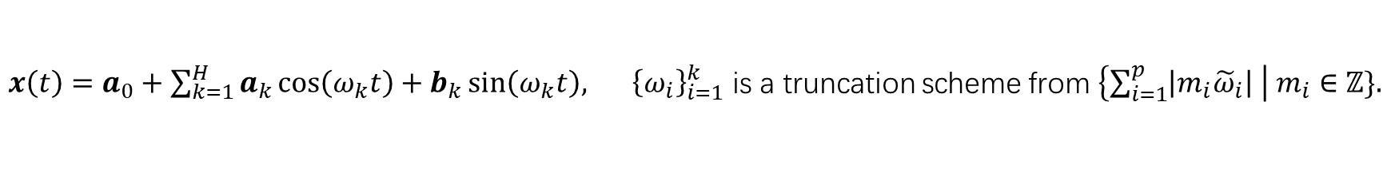
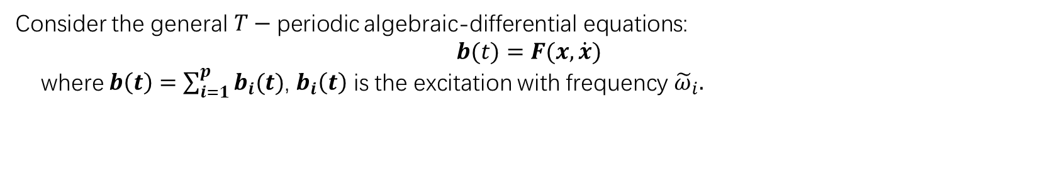
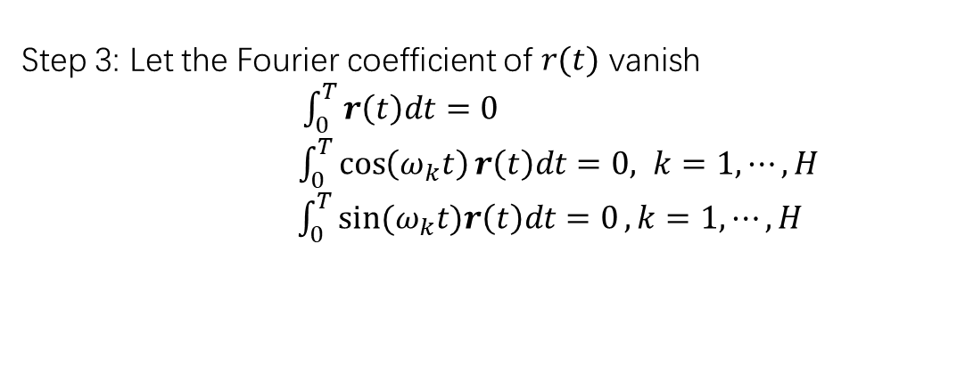
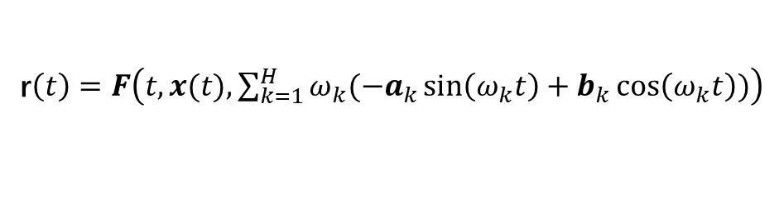
General (multiple tones) HB method
Consider the general $T−$periodic algebraic-differential equations:
$$b(t)=F(x,\dot{x})$$
where $b\left(t\right)=\sum_{i=1}^{p}{b_{i}(t)}$, $b_{i}\left(t\right)$ is the excitation with frequency ${\tilde{ω}}_{i}.$
Step 1: Ansatz solution
$x\left(t\right)=a_{0}+\sum_{k=1}^{H}{a_{k}}\cos\left(ω_{k}t\right)+b_{k}\sin\left(ω_{k}t\right), {\left\{ω_{i}\right\}}_{i=1}^{k}$ is a truncation scheme from $\left\{\sum_{i=1}^{p}{\left|m_{i}{\tilde{ω}}_{i}\right|} \right| m_{i}∈ℤ\}.$
Step 2: Get residual term
r$\left(t\right)=F\left(t,x(t),\sum_{k=1}^{H}{ω_{k}(−a_{k}}\sin\left(ω_{k}t\right)+b_{k}\cos\left(ω_{k}t\right))\right)$
Step 3: Let the Fourier coefficient of $r(t)$ vanish
$\int_{0}^{T}{r\left(t\right)dt=0}$
$\int_{0}^{T}{\cos\left(ω_{k}t\right)r\left(t\right)dt=0, k=1,⋯, H}$
$\int_{0}^{T}{sin⁡(ω_{k}t)r\left(t\right)dt=0},k=1,⋯, H$
(Galerkin method)
$\left(2H+1\right)N$ equations with
$\left(2H+1\right)N$ unknowns

Slide 10

General (two tones) HB method
Let $c=\left[\begin{aligned}\begin{aligned}\begin{aligned}\begin{aligned}a_{0,1} \\ a_{1,1}\end{aligned} \\ b_{1,1}\end{aligned} \\ ⋯ \\ b_{H,1} \\ a_{0,2}\end{aligned} \\ a_{1,2} \\ b_{1,2} \\ ⋯ \\ b_{H,N}\end{aligned}\right]=$ $\left[\begin{aligned}c_{1} \\ c_{2} \\ ⋯ \\ c_{N}\end{aligned}\right], 𝓕^{−1}\left[c\right]\left(t\right)= \left[\begin{aligned}ℱ^{−1}\left[c_{1}\right]\left(t\right) \\ ℱ^{−1}\left[c_{2}\right]\left(t\right) \\ ⋯ \\ ℱ^{−1}\left[c_{N}\right]\left(t\right)\end{aligned}\right],$ where $ℱ$ is the Fourier transform to frequency $\left\{0\right\}∪\{ω_{k}\}_{k=1}^{H} .$
Then we have
$$x\left(t\right)=𝓕^{−1}\left[c\right]\left(t\right),$$
and actually solve
$$𝓕\left[F\left(t,𝓕^{−1}\left[c\right]\left(t\right),\frac{d}{dt}𝓕^{−1}\left[c\right]\left(t\right)\right)\right]=0.$$

Slide 11
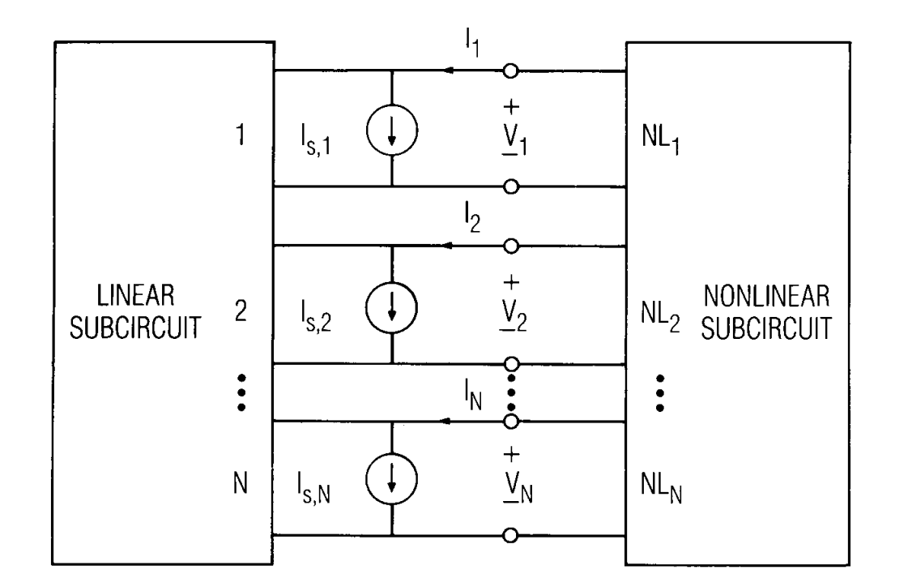


HB method in circuits simulation
Step 1. Formulate circuit partition
Step 2. Formulate HB equation
Linear part
$$i(t)=F(v(t))$$
$$q(t)=Q(v(t))$$
$$I_{s}+YV+𝓕\left[F\left(𝓕^{−1}\left[V\right]\right)\right]+jΩ𝓕\left[Q\left(𝓕^{−1}\left[V\right]\right)\right]=0.$$
Step 3. Solve the HB equation

Slide 12

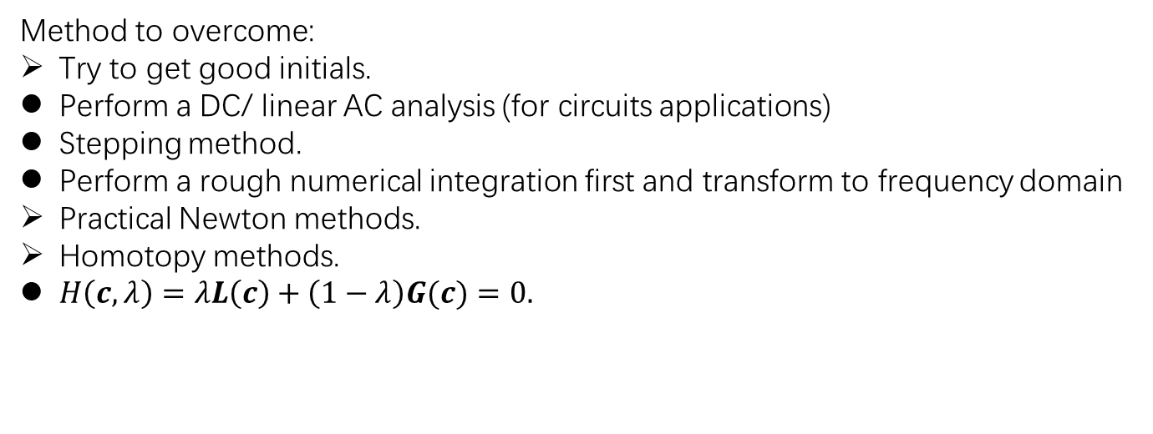
Challenge 1: Convergence
Typically, to solve the HB equation
$$G\left(c\right)=𝓕\left[F\left(t,𝓕^{−1}\left[c\right]\left(t\right),\frac{d}{dt}𝓕^{−1}\left[c\right]\left(t\right)\right)\right]=0,$$
Newton method is often used:
$$c^{(n+1)}=c^{(n)}−{J^{\left(n\right)}}^{−1}G\left(c^{\left(n\right)}\right).$$
However, Newton method has only local convergence.
Method to overcome:
Try to get good initials.
Perform a DC/ linear AC analysis (for circuits applications)
Stepping method.
Perform a rough numerical integration first and transform to frequency domain
Practical Newton methods.
Homotopy methods.
$H\left(c,λ\right)=λL\left(c\right)+\left(1−λ\right)G(c)=0.$

Slide 13
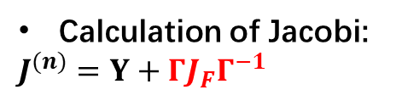

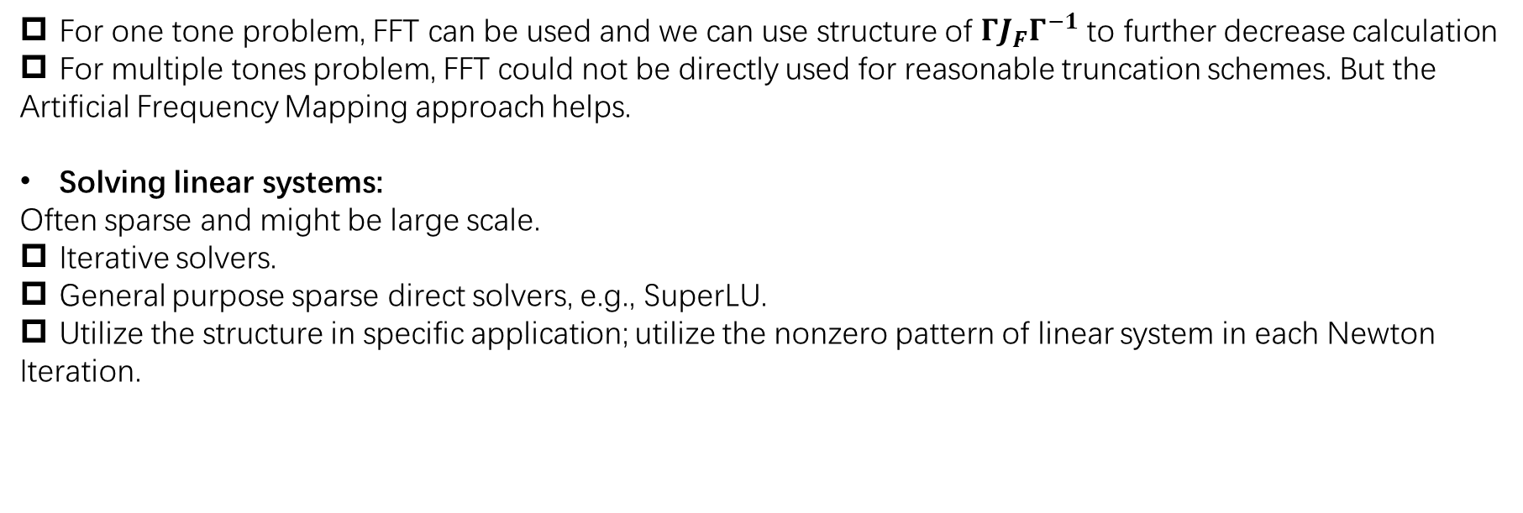
Challenge 2: Efficiency
Typically, timing is mostly spent on calculating Jacobi matrix and solving linear systems.
$$c^{(n+1)}=c^{(n)}−{J^{\left(n\right)}}^{−1}G\left(c^{\left(n\right)}\right),$$
$where G\left(c\right)=I_{s}+YV+𝓕\left[F\left(𝓕^{−1}\left[V\right]\right)\right]$ for simplicity.
Calculation of Jacobi:
$J^{(n)}=$ $Y+ΓJ_{F}Γ^{−1}$
For one tone problem, FFT can be used and we can use structure of $ΓJ_{F}Γ^{−1}$ to further decrease calculation
For multiple tones problem, FFT could not be directly used for reasonable truncation schemes. But the
Artificial Frequency Mapping approach helps.
Solving linear systems:
Often sparse and might be large scale.
Iterative solvers.
General purpose sparse direct solvers, e.g., SuperLU.
Utilize the structure in specific application; utilize the nonzero pattern of linear system in each Newton
Iteration.

Slide 14
When HB does not work?
Too many tones
Very strong nonlinearities

Slide 15
Q & A

